Slide 1
Presentation on:
Privacy-Preserving Approach PBCN in Social Network With Differential Privacy(comment).
Aryan Padhiar
22125024

Slide 2
Topics to cover:
“PBCN” privacy preserving based on clustering and noise. Mainly the whole idea revolves around clustering and adding random noises.
Introduction
Previous developments
What are we doing(along with code)
Results
Performance

Slide 3
Introduction
In today’s digital world, social networks play an important role in engaging people and creating connections.Most of social media apps work this way like X,Reddit,Linkedin. However, mass user and privacy issues have become increasingly apparent. It includes concerns about leaks of sensitive information, scrutiny of individual behavior, and invasion of privacy. Despite the ability of the traditional differential privacy protection system to protect sensitive information,loopholes are found over time again and again. Dilemma arises at the time of deciding what amt of noise to add,creating a trade-off between utility and privacy
The company is based on managing social network applications, which rely on trust relationships for their power, and ensuring that customer records are private.

Slide 4
Previous developments
The concept of k-anonymity and L-Diversity. k-anonymity was built on the idea that by combining sets of data with similar attributes, identifying information about any one of the individuals contributing to that data can be obscured. k-Anonymization is often referred to as the power of “hiding in the crowd.” Individuals’ data is pooled in a larger group, meaning information in the group could correspond to any single member, thus masking the identity of the individual or individuals in question.
L Diversity ensures that no individual’s information can be identified from at least L other individuals in the dataset based on a sensitive attribute – protecting both sensitive attributes and general attributes. By way of example, in a dataset that contains sensitive attributes like prescription medicines or medical diagnoses, L Diversity ensures that there are at least L people in the dataset for any specific sensitive attribute – thus protecting the identities of any specific individual.
Similar to K Anonymity, L Diversity can’t guarantee absolute privacy protection for anonymized data. It’s much more difficult to implement than K Anonymity since identification and protection of sensitive attributes can only work if there are at least L distinct values for each sensitive attribute in the dataset.
For example, if we have a group of records anonymized under k-anonymity, l-diversity ensures that within this group, there are at least l different values for the sensitive attribute. This makes it more challenging for an adversary to infer sensitive information, even in the presence of rare or unique values. In the context of disease data, l-diversity would ensure that even if a patient has a rare disease, there are multiple instances of that disease within the group, thus preventing easy identification of the individual based on the uniqueness of their condition.

Slide 5
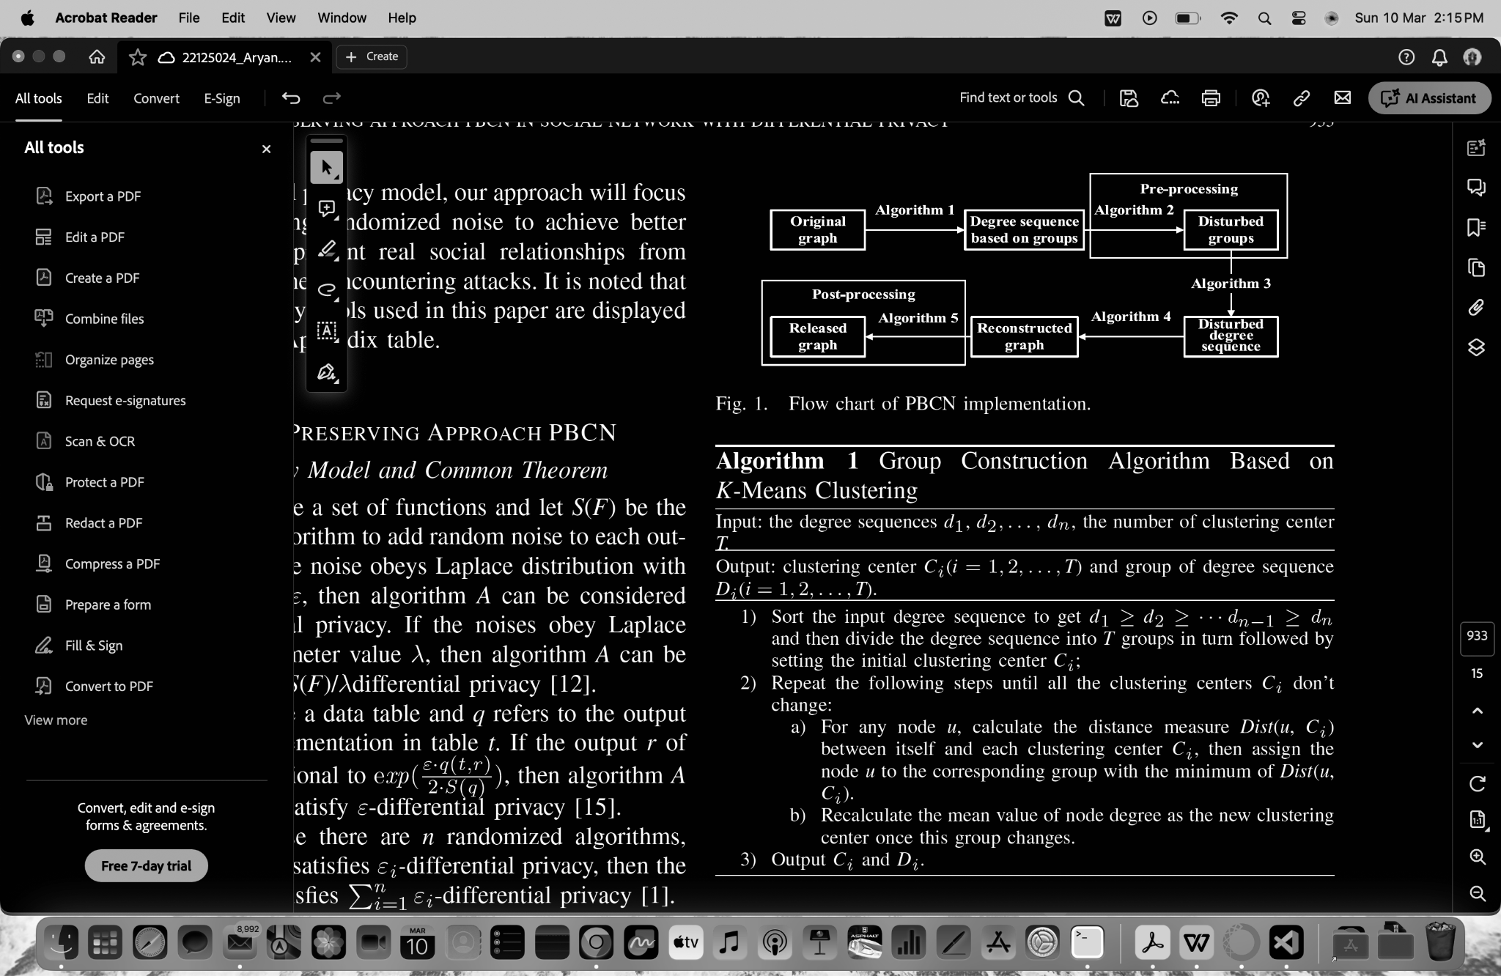
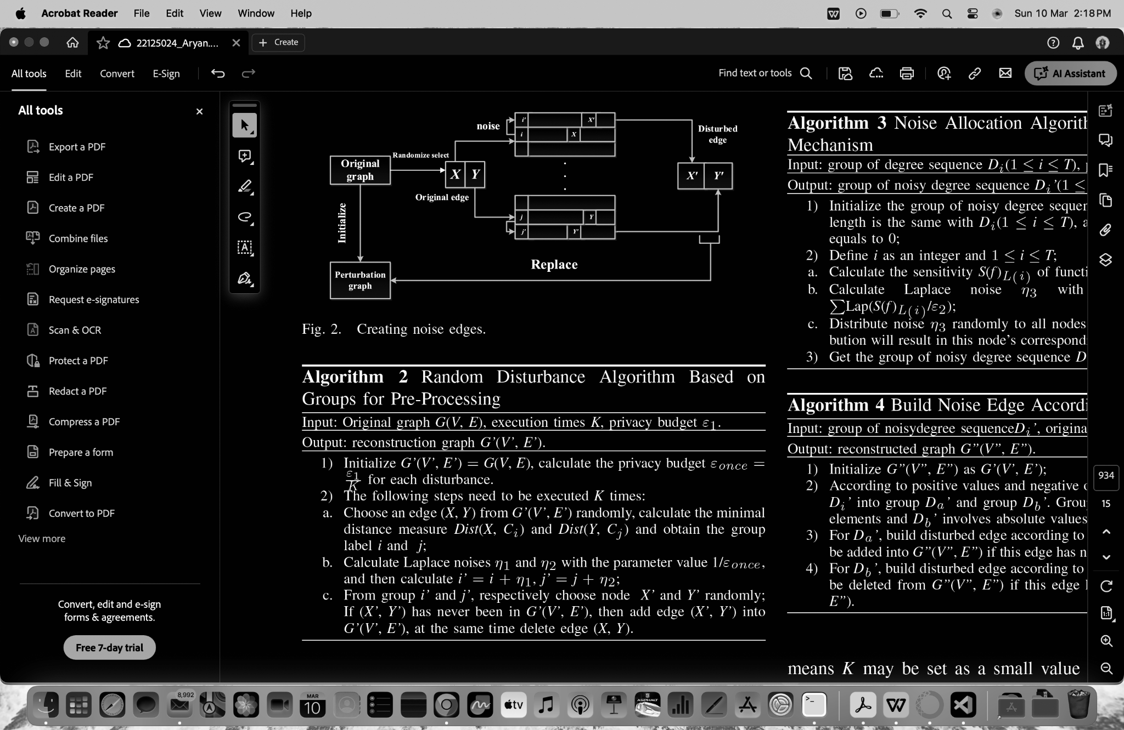
Our procedure
Text here, now lets see code.

Slide 6
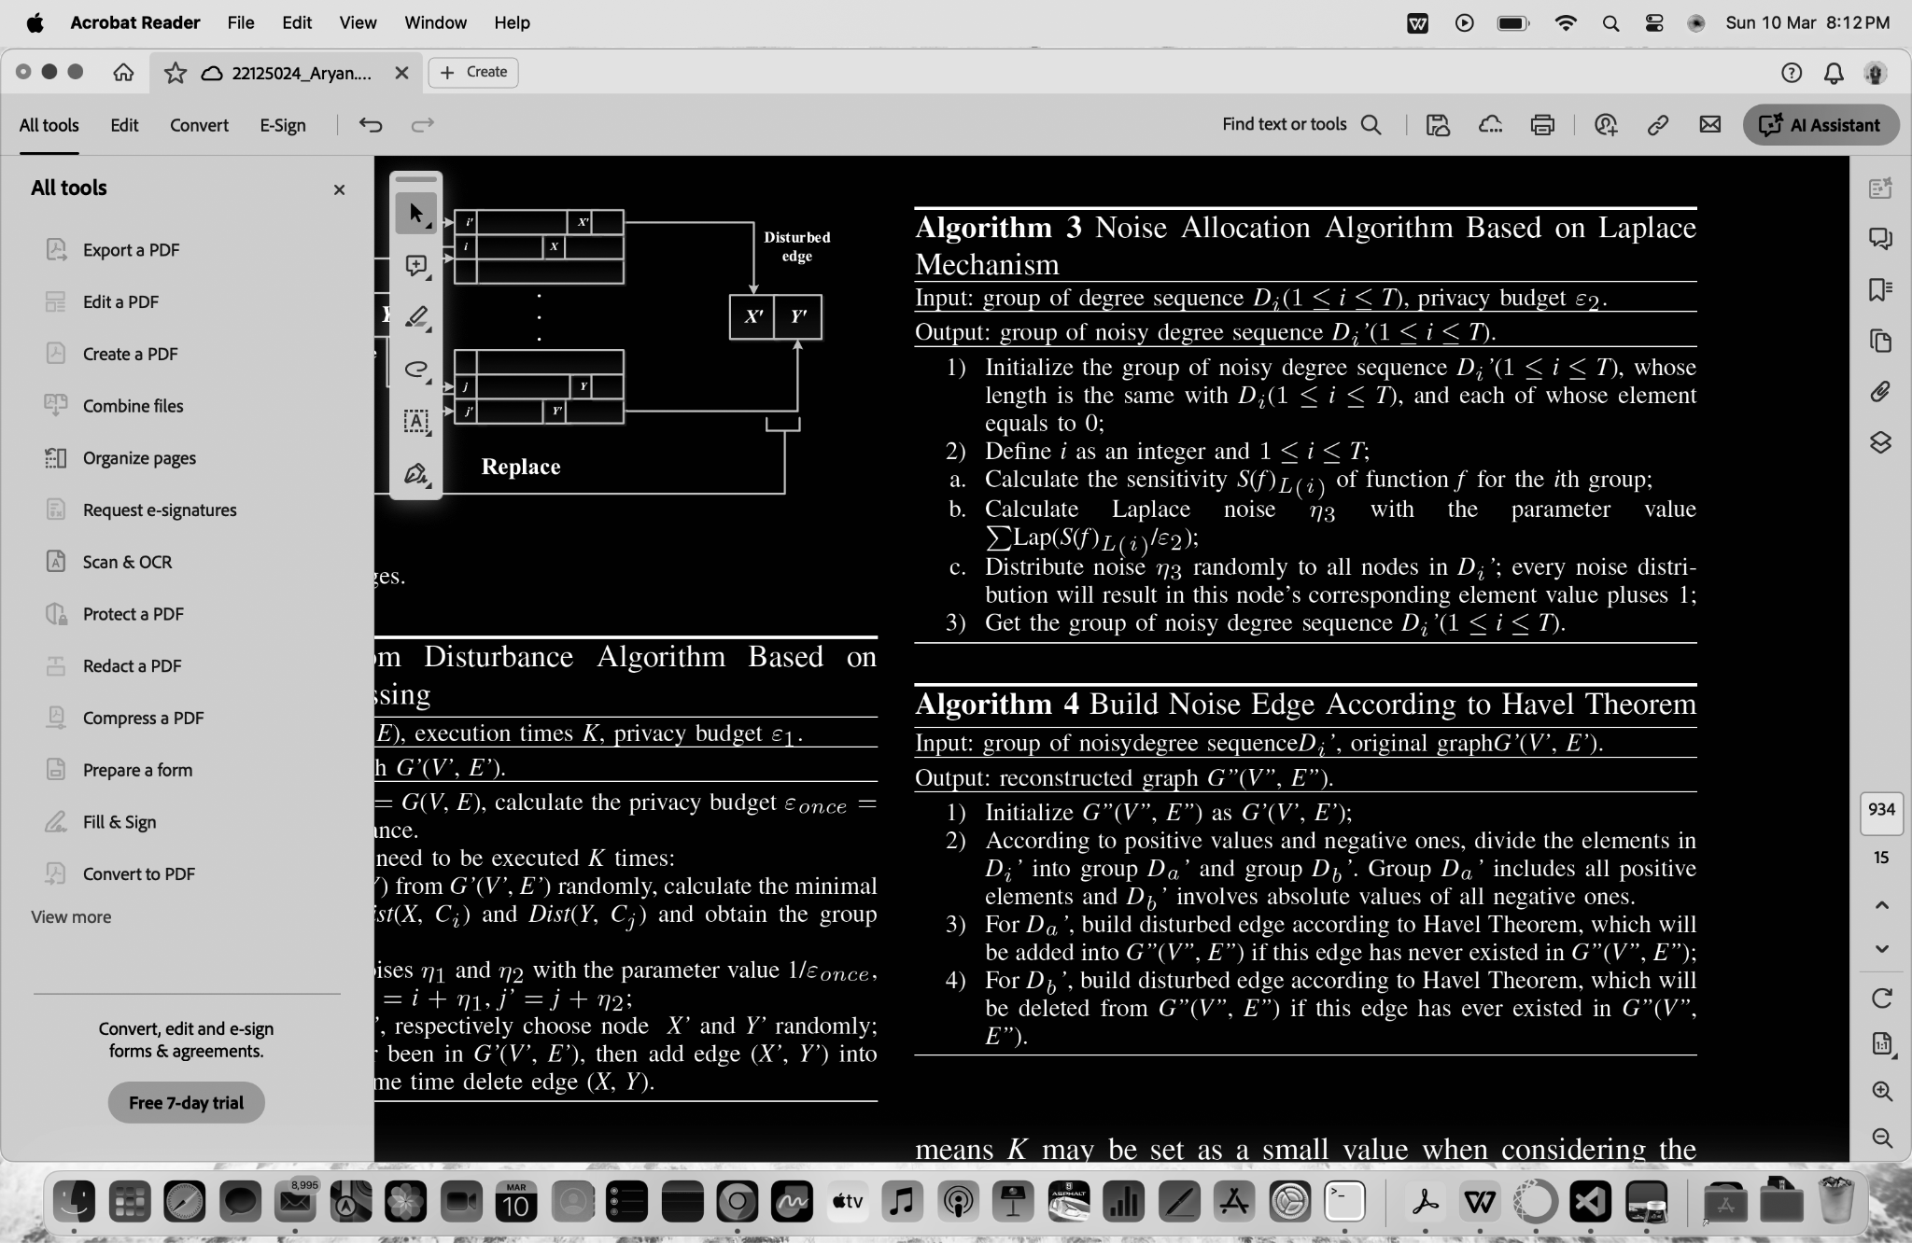
Our procedure
Text here, now lets see code.

Slide 7
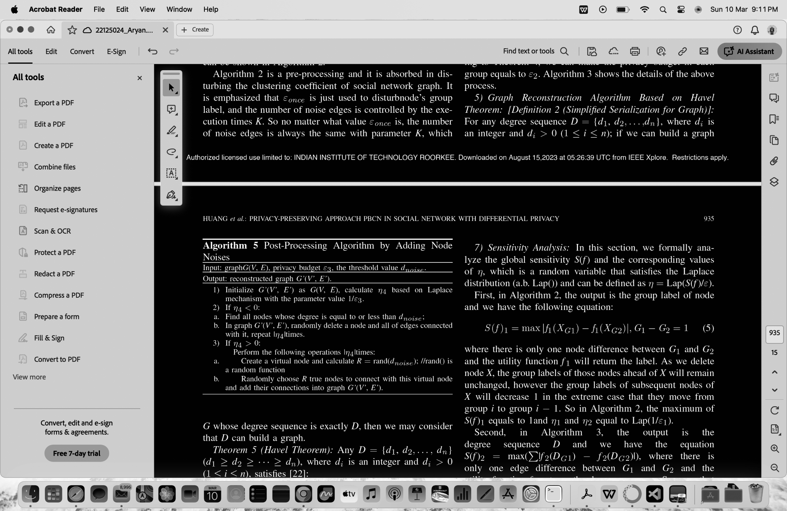
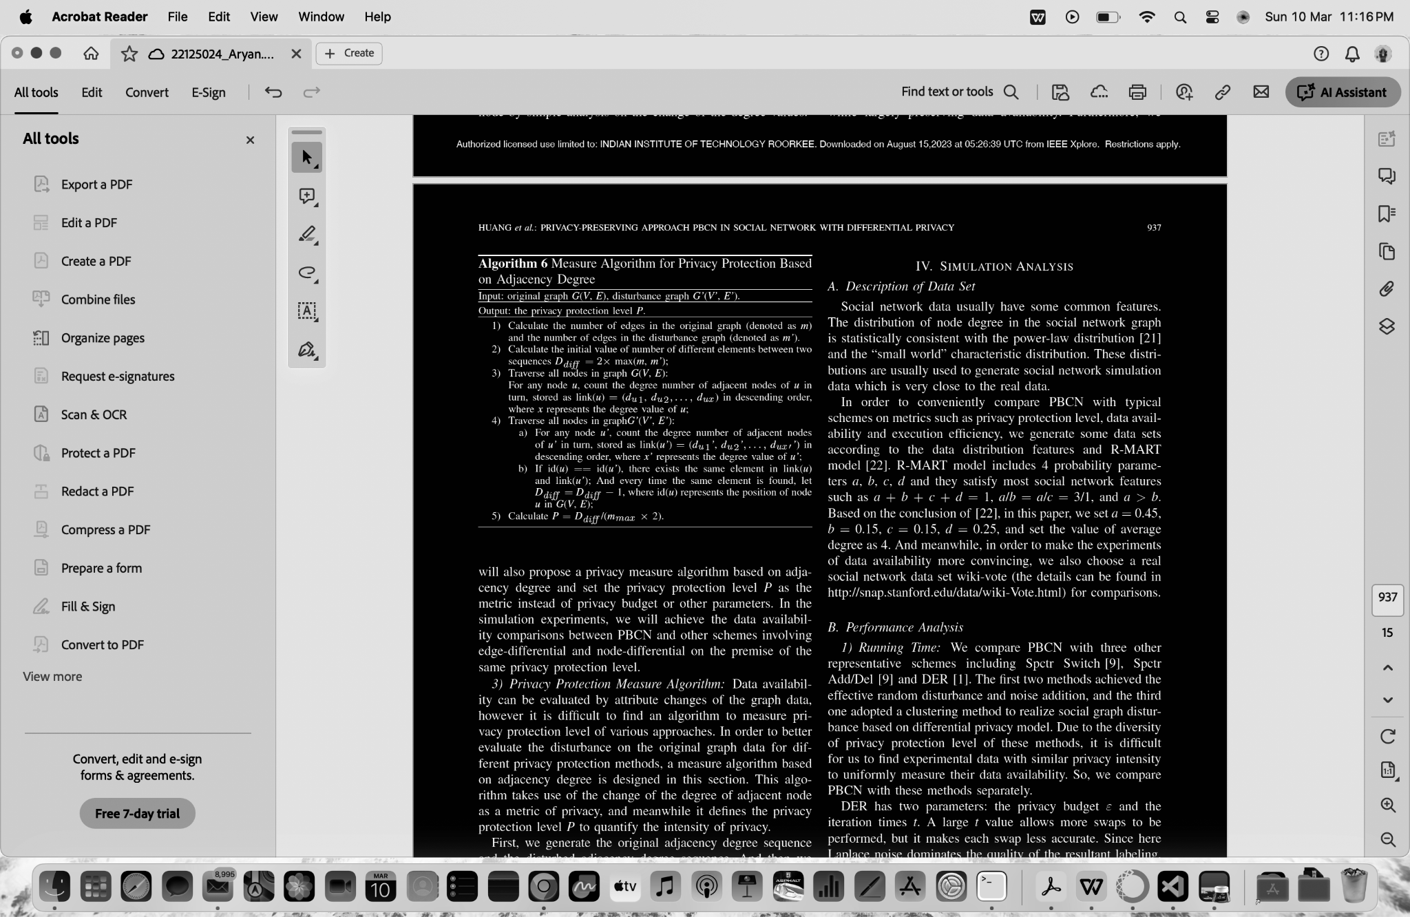
Our procedure
Text here, now lets see code.

Slide 8
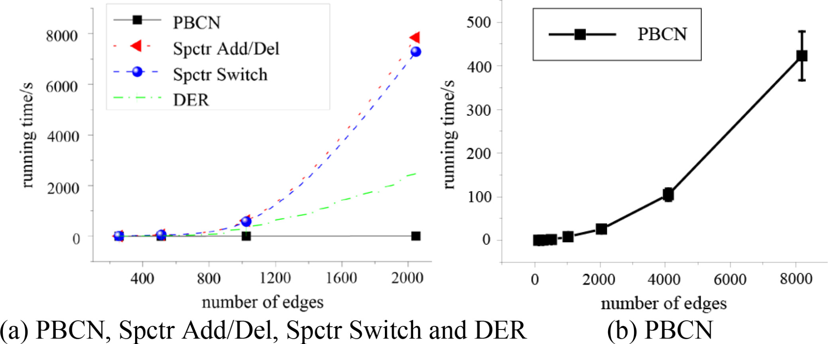
Analysis and results.
We compare PBCN with three other representative schemes including Spctr Switch [9], Spctr Add/Del [9] and DER [1]. The first two methods achieved the effective random disturbance and noise addition, and the third one adopted a clustering method to realize social graph disturbance based on differential privacy model.
DER has two parameters: the privacy budget ε and the iteration times t.PBCN has three parameters: the privacy budget ε(ε = ε1+ ε2+ ε3), and the ratio of three parts is set as 1:1:1), the disturbance times K and the number of groups T.
Most operations of PBCN are performed on arrays (the degree sequences) and thus its efficiency is much better than the others. Therefore, it can be found that the running time of PBCN is less than other three schemes.
Compared with DER, PBCN sacrifices some privacy protection level, but effectively reduces the time
-consumption. In social networks, the node relationship changes rapidly, which results in amount of
real-time data expect the less processing time
Now,Analysis based on Data available In social networks, if an edge or a node is changed randomly, the whole graph structure will be changed randomly,
which means the variety of data availability is very complex. Will see on next page…

Slide 9
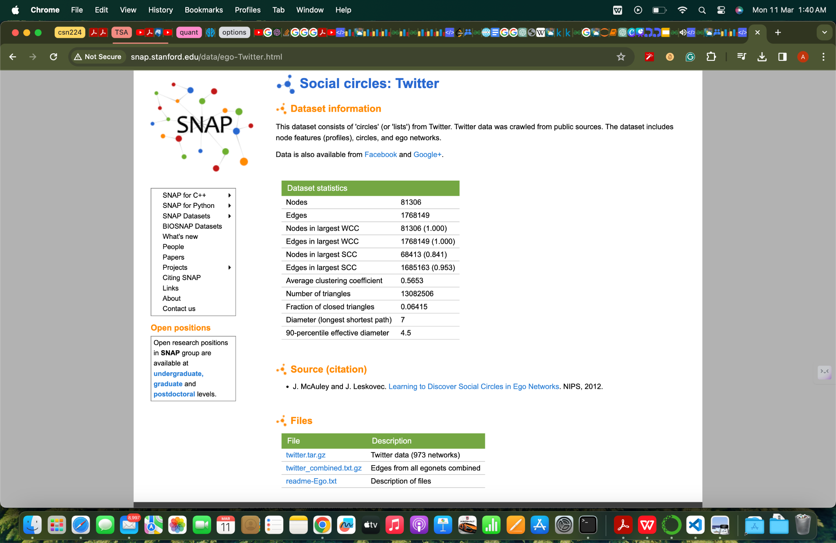
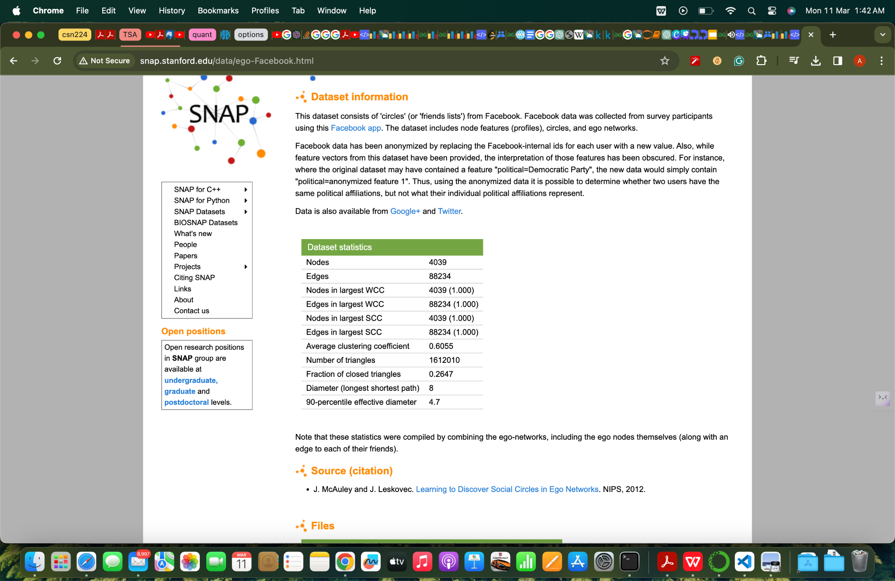
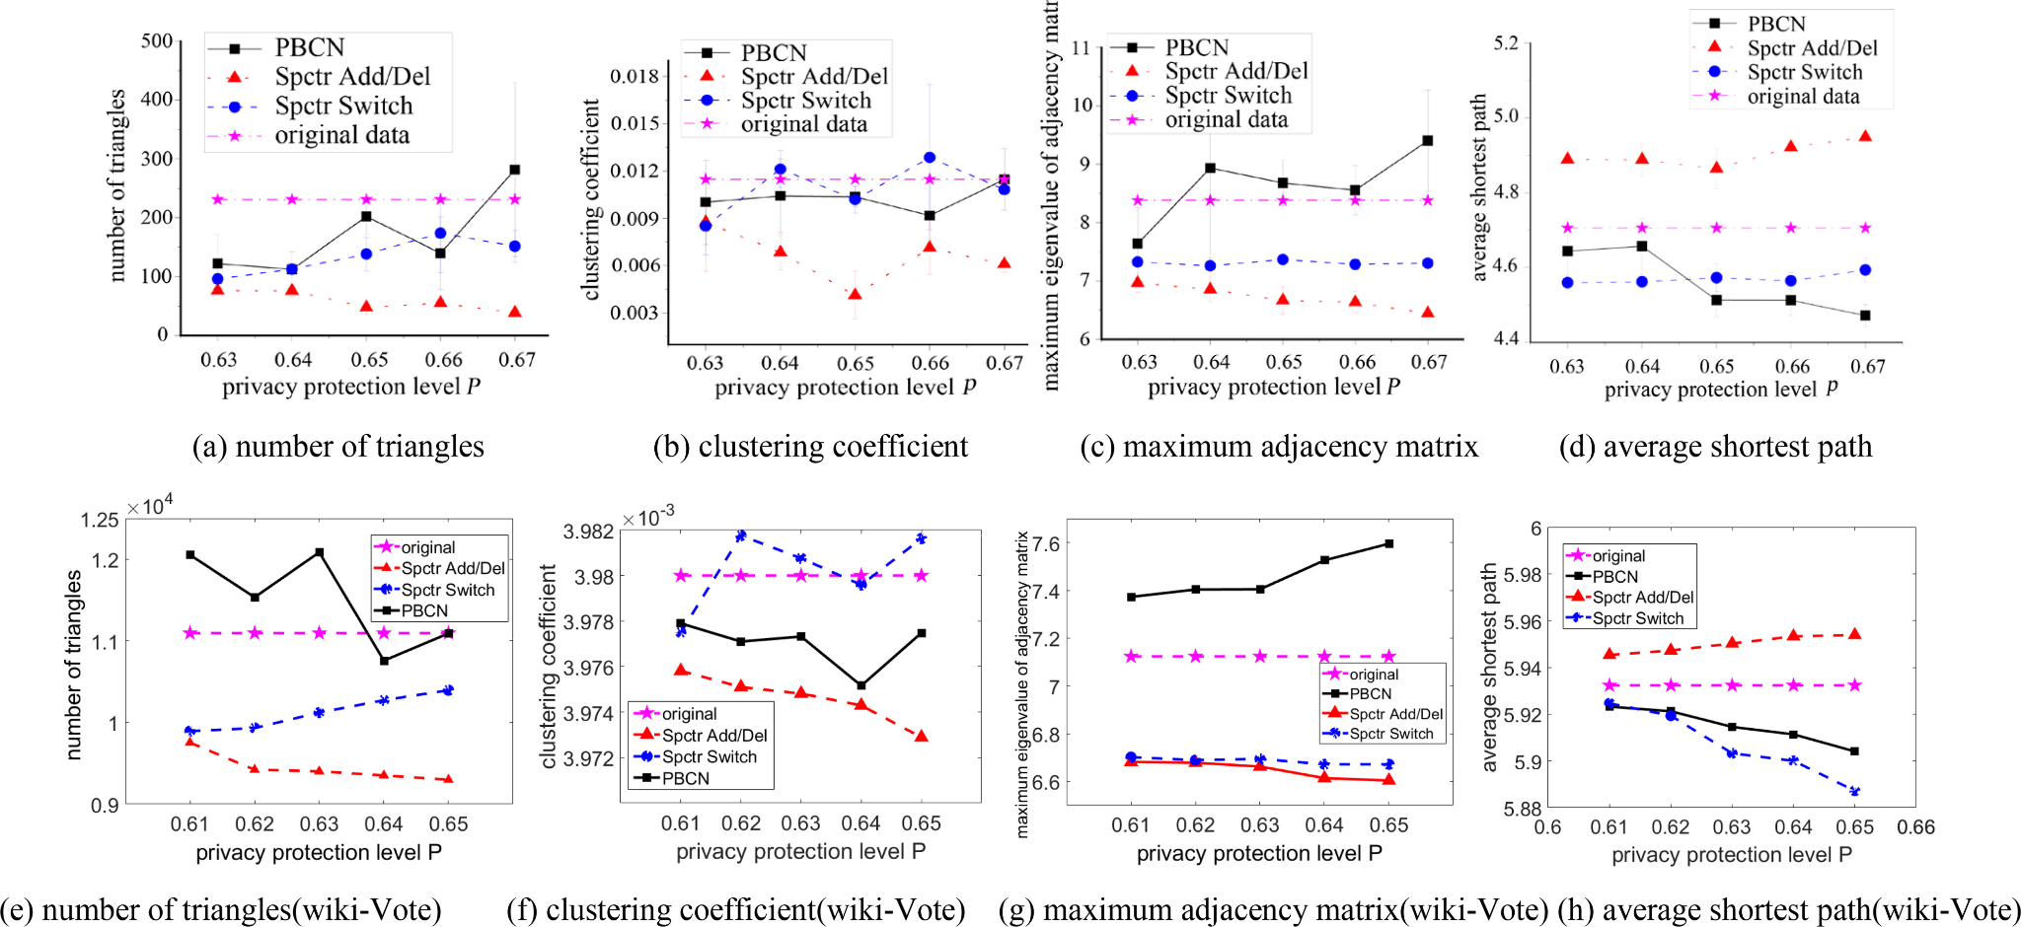
Typical Datasets for
Social networks & graphs showing performance vs features.

Slide 10

Gracias!

